Slide 1
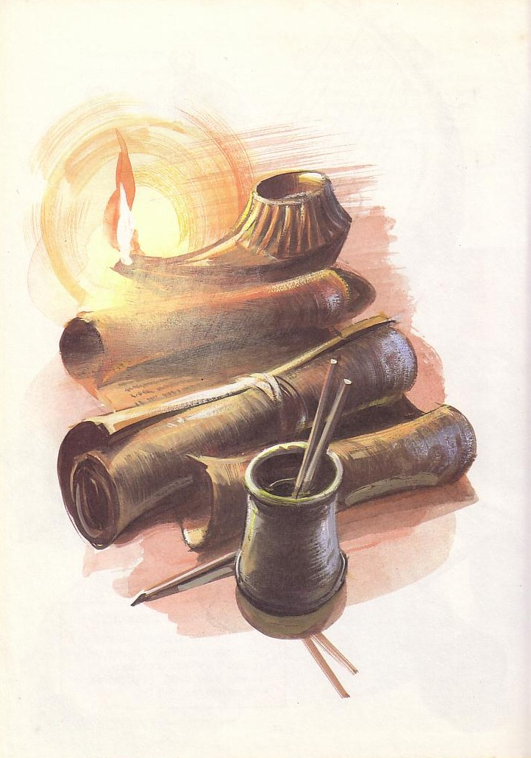
Konteks Kesusastraan Perjanjian Baru
Sumber Utama untuk memahami Abad Pertama
Dr. Rick Griffith • Singapore Bible College • BibleStudyDownloads.org

Slide 2
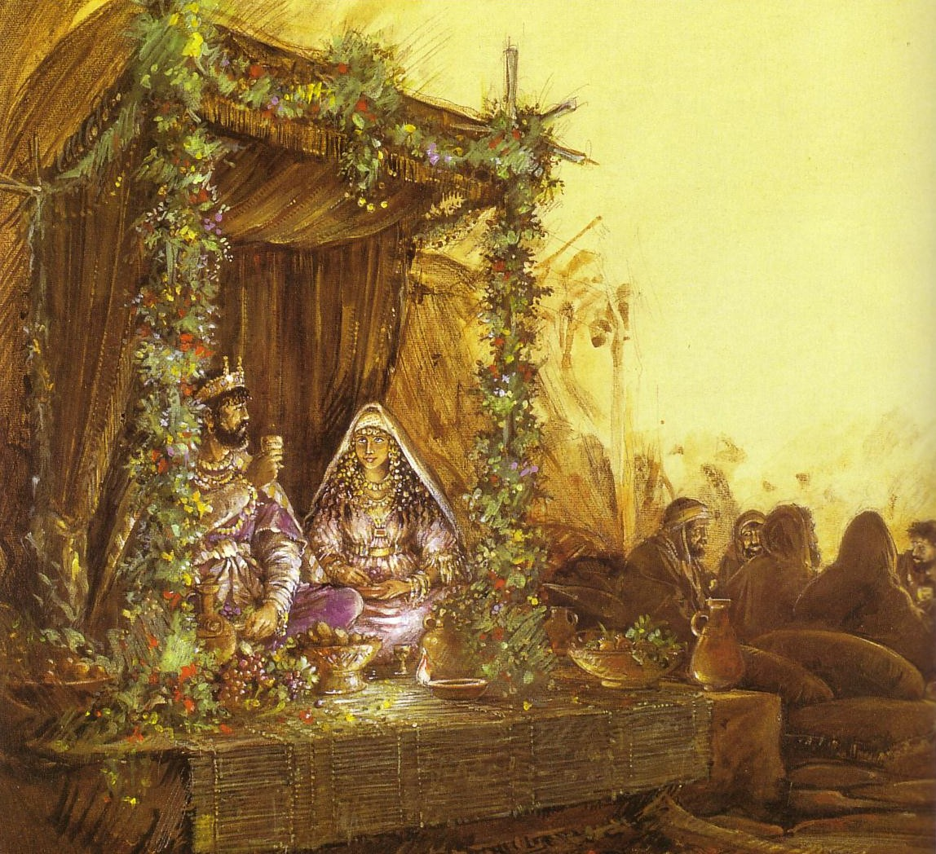
Latar Belakang Perkawinan di Kesusastraan Yahudi
Pernikahan menggambarkan kasih Kristus untuk gereja (ef 5)
Tata tradisi pernikahan sejajar dengan eskatologi gereja

Slide 3
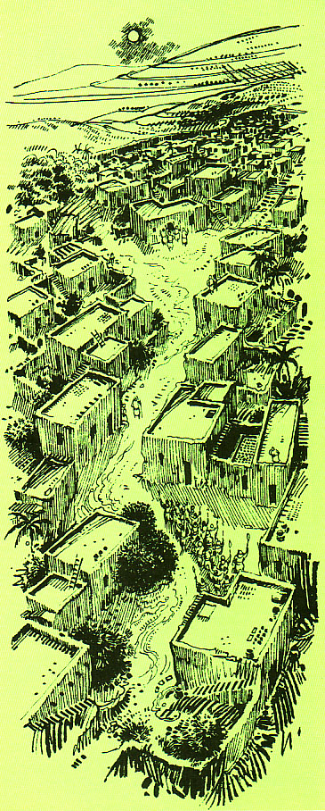
Prosesi pernikahan Abad Pertama
Rumah mempelai pria
Prosesi paralel dengan kedatangan kembali Kristus untuk mempelaiNya, gereja
Rumah mempelai wanita

Slide 4
Marriage & the Church Timeline
Pernikahan & Waktu Gereja
Election God the Father chose those to be saved (Eph. 1:5, 11) | Purchase Christ paid the Father His blood to redeem the church (1 Pet. 1:18) | Sign New covenant began with the cup of the Supper (Luke 22:20) | Our Job Holiness for Christ during church age (2 Cor. 11:2) | Christ’s Job Preparing heaven for church until He returns (John 14:1-3) | Rapture Christ brings church to heaven at unexpected time w/ shout (1 Thess. 4:14-18) | Wedding Church cleansed & presented unspotted (rewarded) in heaven (Eph. 5:26) | Supper to Come Church unites with Christ & glorifies Him for imparting righteousness (Rev. 19:7-9) | Second Coming & Supper Saints & Christ return to earth to reign (Rev. 19:11-20:6)
Church Age
Tribulation
Millennium
(Separation of Church & Christ)
Betrothal Period
(Separation of Bride & Groom)
Choice (Shiddukhin) Father chose a bride for his son (Tobit 4.12-13; 7.9-13; Ecclesiast. 7.23; Sirach 7.25; Mishna Kiddushin 2.1) | Purchase (Mohar) Groom paid bride’s father gold & silver or service as dowry (Tobit 8.21; Jub. 28.2) | Sign (Ketubah) Marriage covenant began with contract & cup of betrothal (Tobit 7.14-15; Kidd. 2.2; Ketuboth 1.2) | Bride’s Job (Kedeshet) Maintained virginity (set apart for groom) one year (Mishna Sotah 1.1, 5; 5.1; Sirach 42.10) | Groom’s Job (Huppah) Prepared bridal chamber and place in home of his father (1 Macc. 3.56; 2 Enoch 61.2) | Procession (Nissuim) Groom unexpectedly arrived, called bride & escorted her to his father’s house (Adam & Eve 22.3; 4 Ezra 6.23) | Wedding (Sheva Brachot = 7 Nuptial blessings) bride washed, adorned, presented by groom as beautiful virgin (Tobit 7.13) & declared married | Wedding Supper Intercourse (Mishna Ketuboth 1.1; 3 Macc. 1.19; 4.6) began a 7-14 day feast (Tobit 8.19-20; 9.6); guests given white linen & groom praised for beauty given to the bride | Married Life Bride & groom lived in society to serve God together (Gen. 2:24; Matt. 19:4-6) 9th ed. 22-May-03

Slide 5
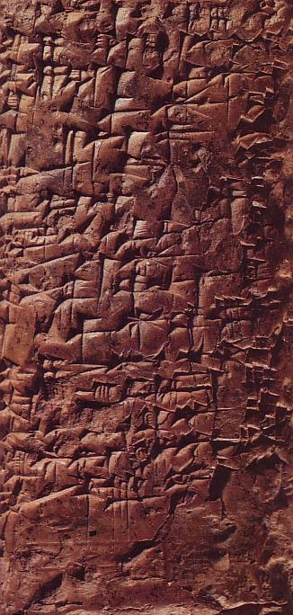
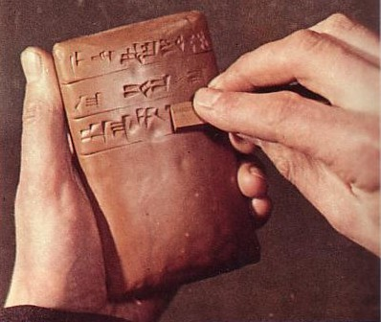
Tulisan Cuneiform
Mengawali Ibrani beratus-ratus tahun

Slide 6
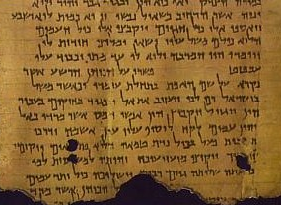
Garis besar bagian Literatur
154-198
Tulisan yang terinspirasi
  PL
  PB
Tulisan yang tidak terinspirasi
  Yunani
  Romawi
  Yahudi
  Kristen
  Gnostik

Slide 7

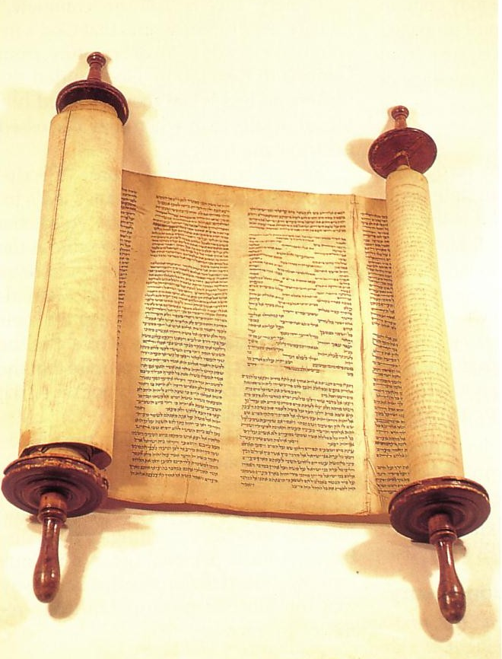
Tabel Kronologi Sastra
158
Dates show time of writing and works appear in italics
400 300 200 100 BC/AD 100 200 300 400 500 600 700
Yunani LXX
(PL Yunani)
Polybius
Diodorus
Strabo
Plutarch
----- Hermetica ----
Philo
Yahudi ^{(Yahudi/Yunani)}
OT Jamnia “Council” MT
(completed) 600-1000
------OT Apocrypha-----
---------- Pseudepigrapha -------(some extended to 7th century)
- Dead Sea Scrolls -
---------------- Rabbinic Literature --------------
------------- Midrash (oral tradition) ----------
Talmud = Mishnah 200 + Gemara 500
--- Tosefta ---
Josephus 77-94
ROMAWI (Jew writing for Rome)
Cicero
Livy
Pliny 113
Tacitus 115
CHRISTIAN
New Testament 40s-95
Apostolic Fathers 95-150
Most notable:
• Didache 95-120
• Epistle of Barnabas 70-132
----------------- NT Apocrypha ----------------
• Nag Hammadi Codices (Gnostic)
• Gospel of Thomas
MISCELLANEOUS
------------------------------- Select Papyri --------------------------------------------

Slide 8

I. Tulisan yang terinspirasi
154-157
A. Perjanjian Lama
1. Ibrani: Teks Masoretik (TM)
2. Yunani: Septuagint (LXX)
3. Kanonitas PL
B. Perjanjian Baru
1. Tanggal
2. Kanonitas PB

Slide 9

Tulisan Yahudi
The Book of Psalms

Slide 10
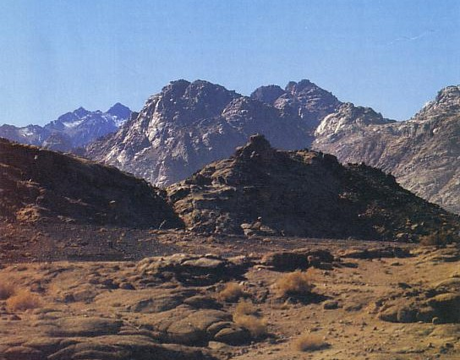
Kita tidak memiliki tulisan Yahudi hari ini yang ada sebelum Gunung Sinai (1445 BC)

Slide 11
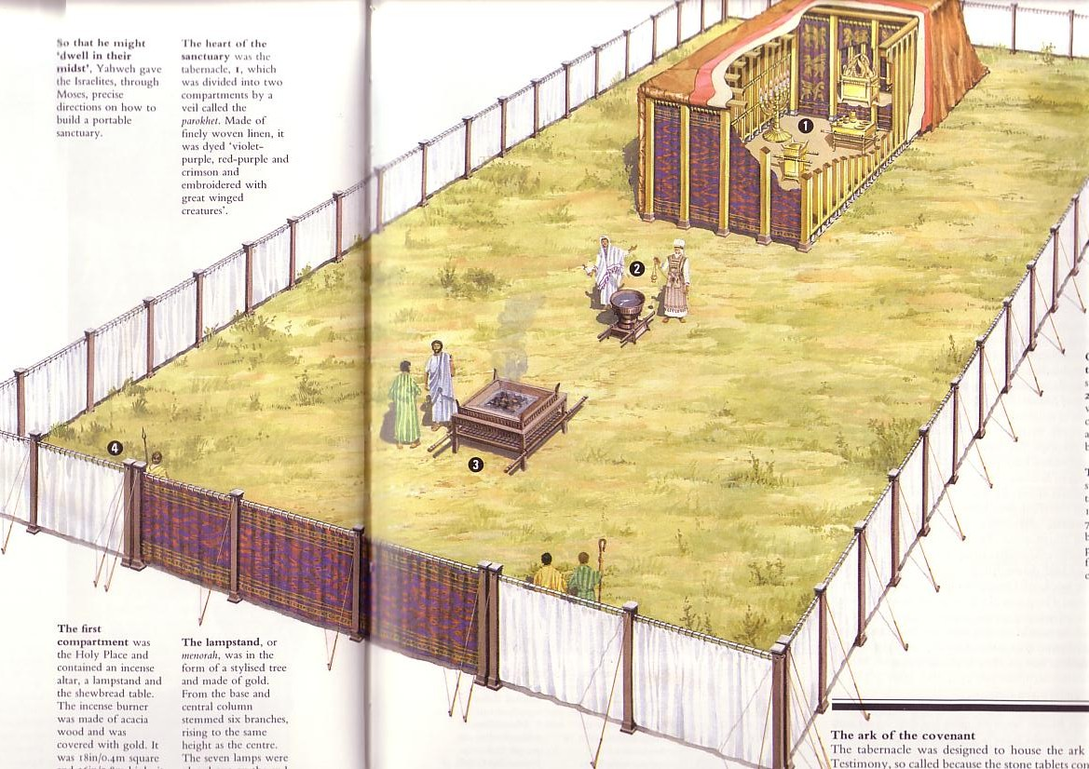
Sumber Utama Yahudi Mulai dari Kemah Perjanjian

Slide 12
Tabel Kronologi Sastra
158
Dates show time of writing and works appear in italics
400 300 200 100 BC/AD 100 200 300 400 500 600 700
YUNANI LXX
(PL Yunani)
Polybius
Diodorus
Strabo
Plutarch
----- Hermetica ----
Philo
YAHUDI ^{(Jewish/Greek)}
PL Jamnia “Council” MT
(completed) 600-1000
------OT Apocrypha-----
---------- Pseudepigrapha -------(some extended to 7th century)
- Dead Sea Scrolls -
---------------- Rabbinic Literature --------------
------------- Midrash (oral tradition) ----------
Talmud = Mishnah 200 + Gemara 500
--- Tosefta ---
Josephus 77-94
ROMAWI (Jew writing for Rome)
Cicero
Livy
Pliny 113
Tacitus 115
CHRISTIAN
New Testament 40s-95
Apostolic Fathers 95-150
Most notable:
• Didache 95-120
• Epistle of Barnabas 70-132
----------------- NT Apocrypha ----------------
• Nag Hammadi Codices (Gnostic)
• Gospel of Thomas
MISCELLANEOUS
------------------------------- Select Papyri --------------------------------------------

Slide 13
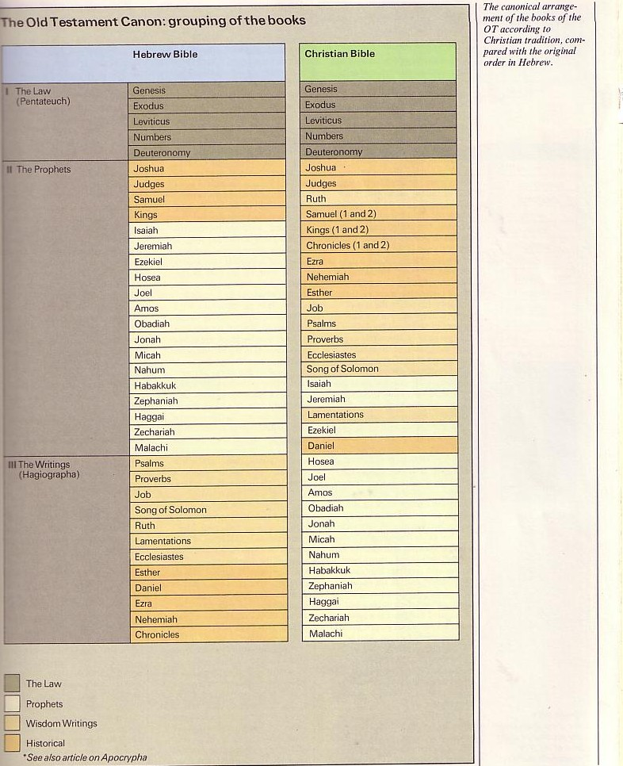
The Hebrew Canon
154
Kanon Ibrani
Buku Yahudi dan Kristen sama tapi beda urutan dan klasifikasi

Slide 14
The Hebrew Canon
154
Kanon Ibrani
?
Matius 5:17 "Janganlah kamu menyangka, bahwa Aku datang untuk meniadakan hukum Taurat atau kitab para nabi. Aku datang bukan untuk meniadakannya, melainkan untuk menggenapinya .”
Jewish and Christian books are the same but in different order and classification

Slide 15
The Hebrew Canon
154
Kanon Ibrani
Lukas 24:44 “….”
Jewish and Christian books are the same but in different order and classification

Slide 16

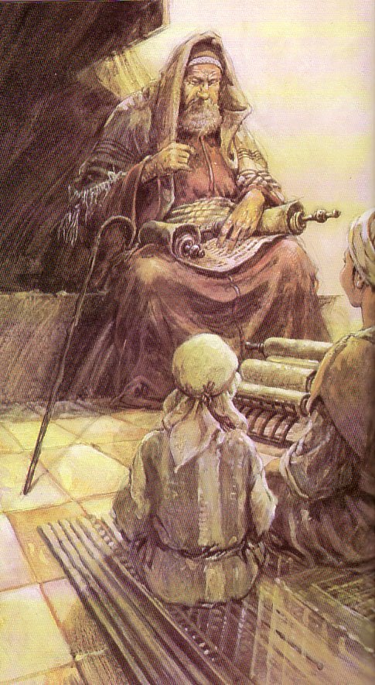
1. Ibrani: Teks Masoretik (TM)
155
Teks yang tidak dipoin
  (1400 BC – AD 800)
~yhla arb tyvarb
mhl rb hthsrb

Slide 17
Kamu juga dapat membaca tanpa huruf hidup!
Kt jrng mmbc bhs tnp
vwl tp mngkn dngn lthn.
n bhkn mnynngkn!
Kita jarang membaca bahasa tanpa vowel tapi mungkin dengan latihan.
Ini bahkan menyenangkan!

Slide 18
1. Ibrani: Teks Masoretik (TM)
155
Teks tanpa poin
  (1400 BC – AD 800)
teks dengan poin oleh Masoret
  (AD 800 – masa kini)
~yhla arb tyvarb
mhl rb hthsrb
mihole arab htihsereb
Bereshith bara elohim
In the beginning God created
~yhi_l{a/ ar"äB' tyviÞarEB.

Slide 19
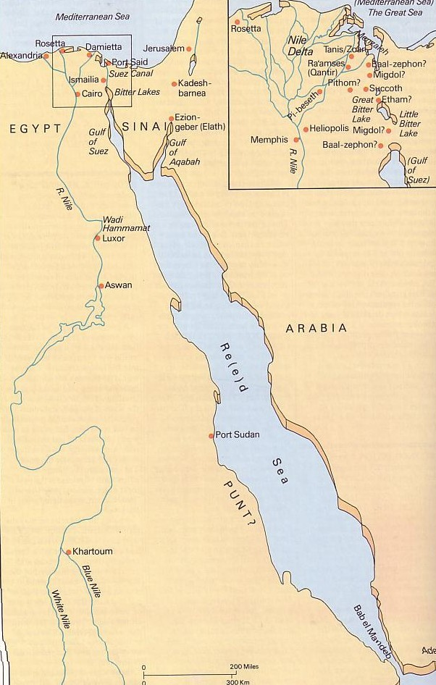
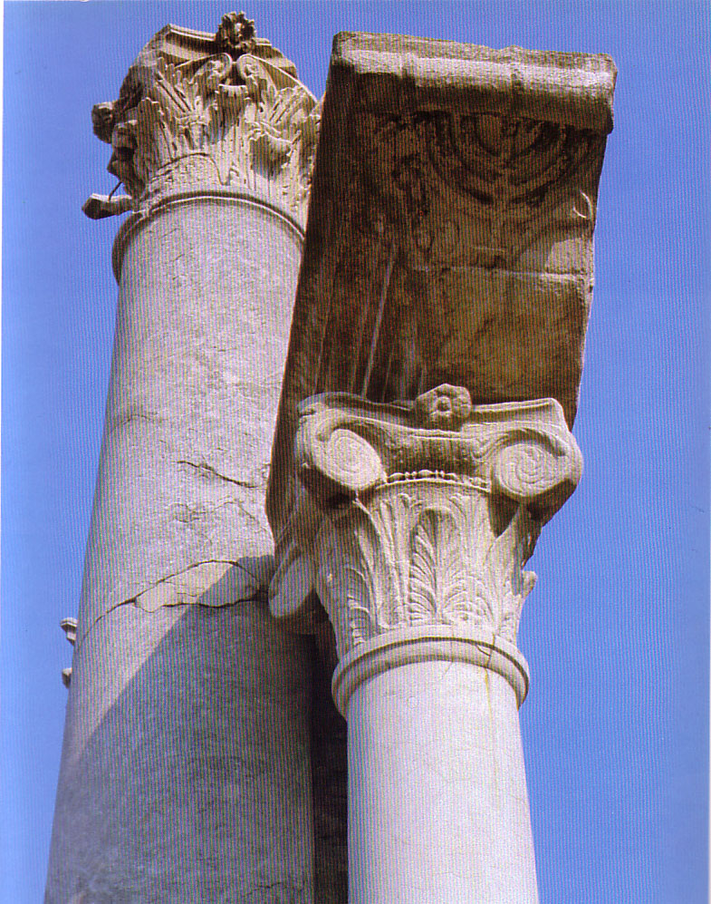
2. Yunani: Septuagint (LXX)
155
PL Ibrani diterjemahkan ke Yunani di Alexandria sekitar 250 BC
~yhla arb tyvarb
evn avrch/| evpoi,hsen o` qeo.j

Slide 20

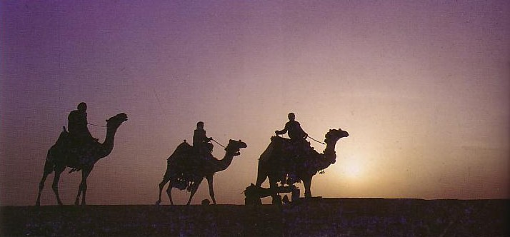
3. Kanonitas PL
155-156
Mengapa diadaptasi telat?
Apocrypha
LXX
Antilegomena
Samaritans
Pharisaical Tradition
Kriteria apa yang digunakan?
Authoritative & Enduring
Doctrinal Suitability
Prophetic Authorship
Claim to be God’s Word
Dynamic Character
Canonicity is vital for those seeking God

Slide 21
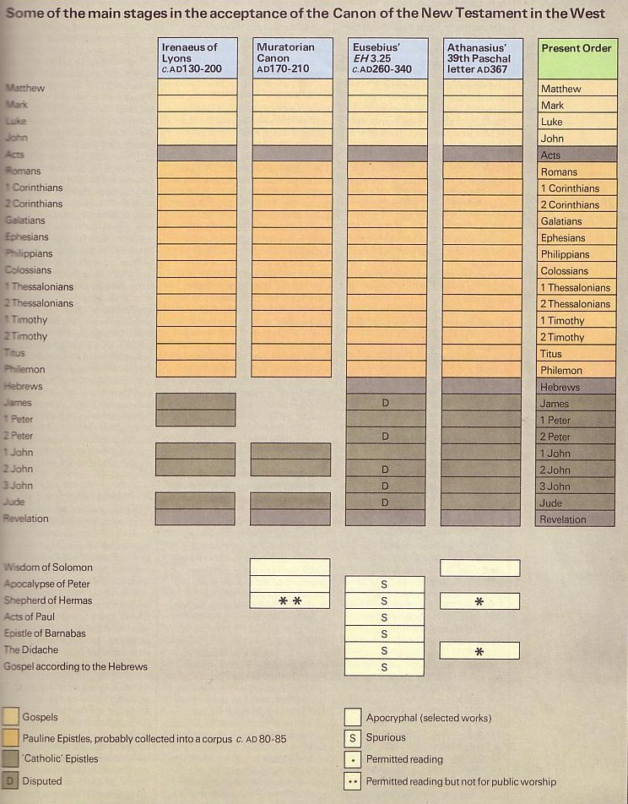
Kanonitas PB
156-157
Apostolik
Diterima

Slide 22
Paulus menyebutkan Injil Lukas “Kitab” dalam waktu 5 tahun
For the Scripture says, “Do not muzzle the ox while it is treading out the grain,” and “The worker deserves his wages” (1 Timothy 5:18).
Masedonia
Paulus Menulis 1 Timotius
AD 62
Kaisarea
Lukas ditulis
AD 57-59
Stay in that house, eating and drinking whatever
they give you, for
the worker deserves his wages… (Luke 10:7)

Slide 23
Petrus juga menyebut surat Paulus “Kitab”
Surat Paulus ditulis
AD 49-62
Roma
Petrus Menulis 2 Petrus
AD 64
“…Our dear brother Paul also wrote to you with the wisdom God gave him. He writes the same way in all his letters, speaking in them of these matters. His letters contain some things that are hard to understand, which ignorant and unstable people distort, as they do the other Scriptures, to their own destruction” (2 Peter 3:15-16)

Slide 24
Kanonitas PB
156-157
Apostolik
Diterima
Doktrin

Slide 25
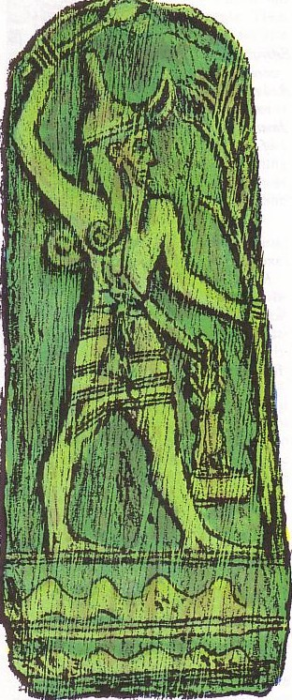
Tulisan yang tidak terinspirasi
159-198
Yunani
Romawi
Yahudi
Kristen
Gnostik

Slide 26
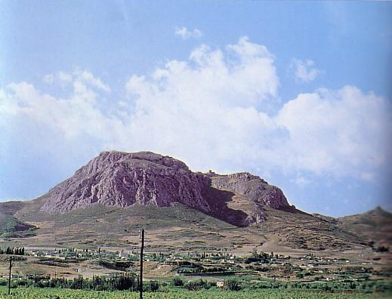
Sejarahwan Yunani
159
(wafat)
Herodotus (420 BC)
Polybius (120 BC)
Diodorus (21 BC)
Strabo (AD 21)
Plutarch (AD 120)
Acrocorinth

Slide 27
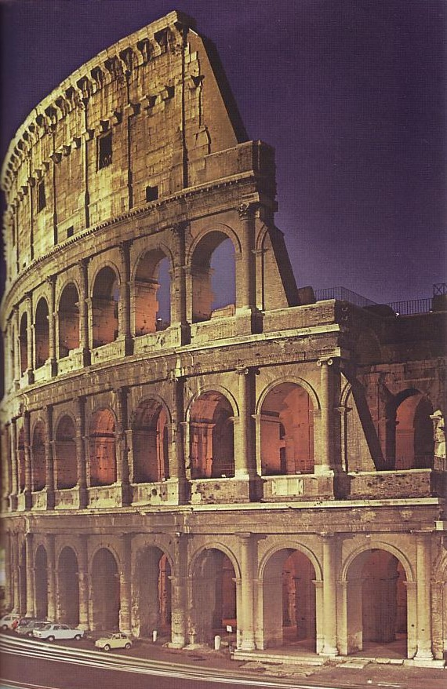
Sejarahwan Romawi
159
(wafat)
Cicero (43 BC)
Livy (AD 17)
Pliny the Younger (AD 113)

Slide 28
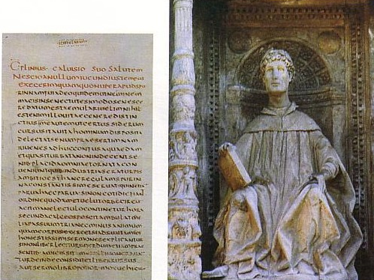
Pliny the Younger (AD 111-113)
159
Menulis surat ke kaisar Trajan
Bilang Kristen berkumpul pada hari tertentu “untuk menyanyi hymn untuk Kristus seolah-olah kepada dewa” (Surat 10.96)—Referensi Latin paling kuno mengenai Yesus Kristus

Slide 29
Sejarahwan Romawi
159
(year of death)
Cicero (43 BC)
Livy (AD 17)
Pliny the Younger (AD 113)
Tacitus (AD 120)
Tentang Kristen yang dianiaya di bawah Nero: “Nama mereka berasal dari Kristus, yang, pada pemerintahan Tiberius dihukum mati oleh gubernur Pontius Pilatus” (Annals 15.44 in AD 115)

Slide 30
Sejarahwan Romawi
159
(year of death)
Cicero (43 BC)
Livy (AD 17)
Pliny the Younger (AD 113)
Tacitus (AD 120)
Suetonius (AD 121)
Klaudius mengusir Yahudi dari Roma “yang terus menerus membuat masalah dibawah pengaruh dari Kristus” (oops!)
(Lives of the Caesars, ch. 25, in AD 120; cf. Acts 18:2)

Slide 31

Tulisan Kafir vs. Tulisan PB
160
# | Pengarang | Kapan | Salinan Mula2 | Kurun Waktu | Salinan
6 | Plato | 347 BC | AD 900 | 1200 yrs | 7
12 | Catullus | 54 BC | AD 1550 | 1600 yrs | 3
14 | Pliny | AD 113 | AD 850 | 750 yrs | 7
NT | Paul, Luke, etc. | AD 95 | AD 200 | 100 yrs | 24,772

Slide 32
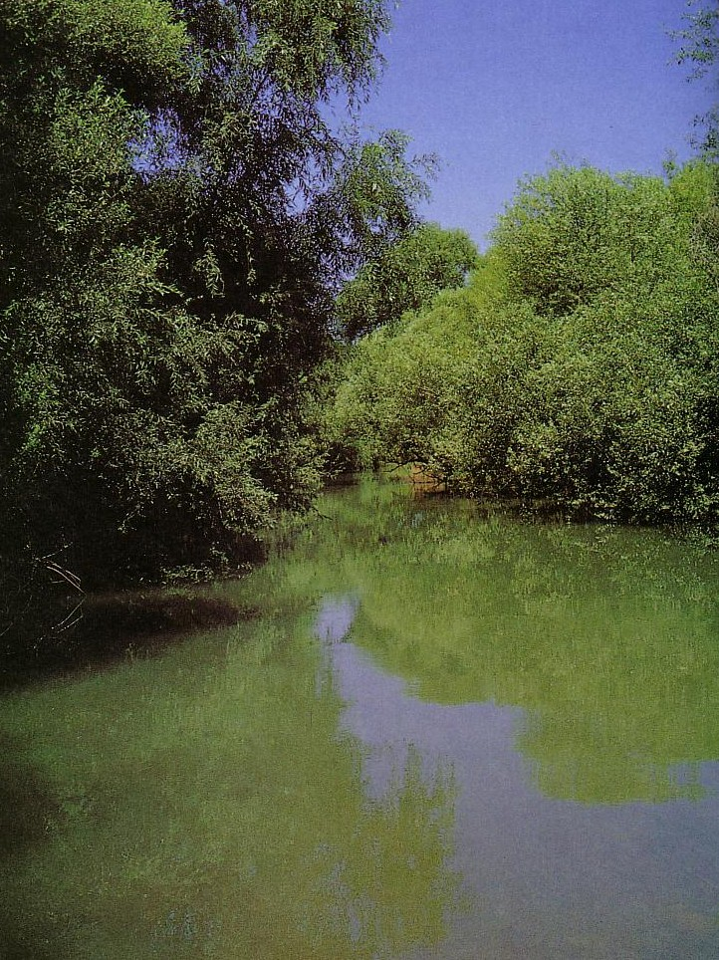
Uninspired Jewish Writings
Tulisan Yahudi tak terinspirasi
161-184b
Apocrypha & Pseudepigrapha
Philo
Rabbinic
Josephus
Dead Sea Scrolls

Slide 33

Apocrypha & Pseudepigrapha
Uninspired Jewish Writings
161
Apocrypha
Apocalypse
Pseudepigrapha
Deuterocanonical
Tersembunyi
Salah Penulisan
Ditemukan
kanon kedua
Bisakah kamu menjodohkan dengan istilah yang benar?

Slide 34
Apocrypha & Pseudepigrapha
Uninspired Jewish Writings
161
Apocrypha
Apocalypse
Pseudepigrapha
Deuterocanonical
= Tersembunyi
= Ditemukan
= Salah Penulisan
= Kanon kedua

Slide 35

Lemari Alkitab

Slide 36
Dimana mereka ditempatkan
Apocrypha - Pseudepigrapha - DSS

Slide 37


Sirach 2:10 (NRSV)
Bandingkan generasi lama dan lihat: apakah ada yang percaya pada Tuhan dan kecewa?
Atau ada yang bertahan karena takut akan Tuhan dan ditinggalkan?
Atau ada yang berseru dan dibiarkan?

Slide 38
Greek Philosopher Timeline
Persia 539-331
Yunani 331-167
Hasmonea 134-37
Romawi 63-
Ptolemy 301-198
Seleucid 198-167
Maccabee 167-134
450
400
350
300
2 5 0
2 0 0
150
100
0
Socrates 470-399
Plato 427-347
Lucretius 98-55
Aristotle 384-322
Epicurius 340-271

Slide 39
Placement of the Septuagint
Persia 539-331
Yunani 331-167
Hasmonea 134-37
Romawi 63-
Ptolemy 301-198
Seleucid 198-167
Maccabee 167-134
450
400
350
300
2 5 0
2 0 0
150
100
0
Septuagint 255

Slide 40

70 Sarjana

Slide 41

Bagaimana 15 Buku Apocryphal PL diterima? (250 BC-AD 100)?
165
Many
Most
Baruch
Letter of Jeremiah
Additions to Esther
Song of the Three Children
Susanna
Bel and the Dragon
1 Maccabees
2 Maccabees
Tobit
Judith
Wisdom of Solomon
Ecclesiasticus
A few...
1 Esdras
2 Esdras
Prayer of Manasseh
Psalm 151
3 Maccabees
4 Maccabees
Pseudepigraphal

Slide 42
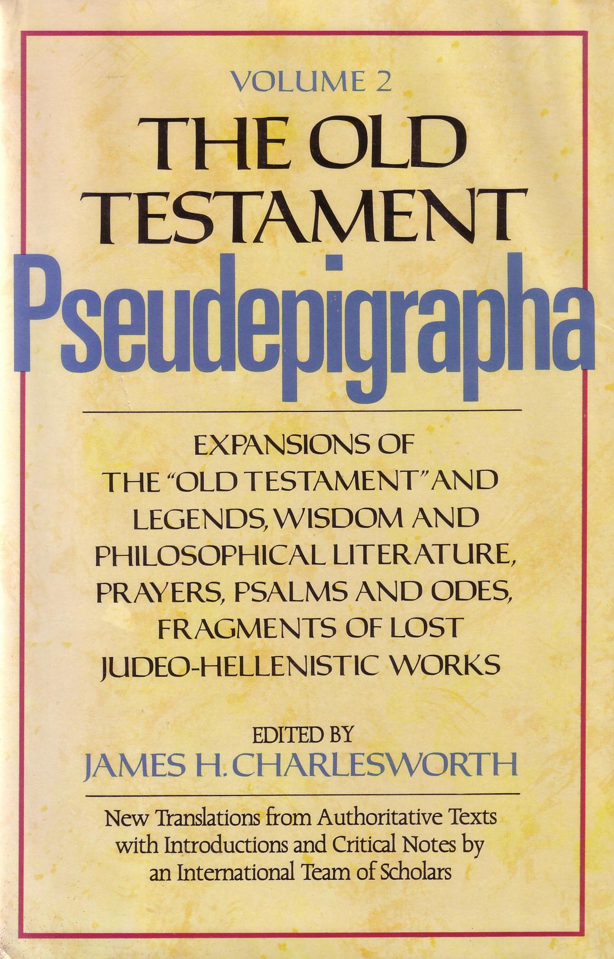
Pseudepigraphayang dipilih (200 BC-AD 200)
166
1 Enoch
Psalms of Solomon
Letter of Aristeas
Sibylline Oracles
Life of Adam & Eve
Testament of the 12 Patriarchs
Book of Jubilees
Lives of the Prophets
3 Maccabees
4 Maccabees
Assumption of Moses
2 Baruch
Ascension of Isaiah

Slide 43
Kategori Sastra
161-162
APOCALYPTIK
1 Enoch
2 Esdras
Kebijaksanaan
Ecclesiasticus
Wisdom of Solomon
Fiksi
Tobit
Judith
Letter of Aristeas
Susanna
Bel and the Dragon
3 Maccabees
Sibylline Oracles
Sejarah
1 Esdras
1 Maccabees
2 Maccabees

Slide 44
Terminologi Tulisan Berdaulat
164
 | Jews | Protestants & Anglicans | Catholics | Eastern Orthodox
39 OT Books | Bible (inspired) | Old Testament (inspired) | Old Testament (inspired) | Old Testament (inspired)
27 NT Books | New Testament (uninspired) | New Testament (inspired) | New Testament (inspired) | New Testament (inspired)
4 Apocryphal Books (Tobit, Judith, etc.) | Apocrypha (uninspired; not in MT but in LXX) | Apocrypha (uninspired) | Deuterocanonical (canonical since 1546) | Apocrypha (canonical since 1673)
8 Apocryphal Books (1-2 Macc) | Apocrypha (uninspired) | Apocrypha (uninspired) | Deuterocanonical (since 1546) | Apocrypha (authoritative)
3 Apocryphal Books (Esdras, Manasseh) | Apocrypha (uninspired) | Apocrypha (uninspired) | Non-canonical (but in appendix) | Apocrypha (authoritative)
3 Pseudepigraphal Books: 3-4 Macc, Psalm 151 only | Pseudepigrapha | Pseudepigrapha (uninspired) | Apocrypha (but in appendix) | Apocrypha (authoritative)
60+ Pseud Books (esp. 1 Enoch) | Pseudepigrapha (uninspired) | Pseudepigrapha (uninspired) | Apocrypha (uninspired) | Pseudepigrapha (uninspired)

Slide 45

Why are these books doubted?
163
Mengapa Buku ini diragukan?
Tidak pernah dianggap tulisan berdaulat
theologi palsu
PENEBUSAN:
Hasil dari korban untuk kafir yang mati-”dan karena dia menebus untuk yang mati sehingga mereka dapat dibebaskan dari dosa mereka”
(2 Maccabees 12:46)
KESELAMATAN MELALUI KERJA:
“It is better to give to the poor than to store up gold. Such generosity will save you from death and will wash away all your sins.”
(Tobit 12:8b-9a GNB)

Slide 46
Why are these books doubted?
163
Mengapa buku ini diragukan?
Tidak dianggap berdaulat
False theologi palsu
tidak terinspirasi
Kurang tokoh yang dinamis
Diduga sejarah dari RCC

Slide 47
So do these books have any value?
163
Apakah ada nilainya?
YA!
Sejarah Intertestamen
Sekte Yahudi dan institusi
Kepercayaan Theologi (e.g., malaikat)

Slide 48
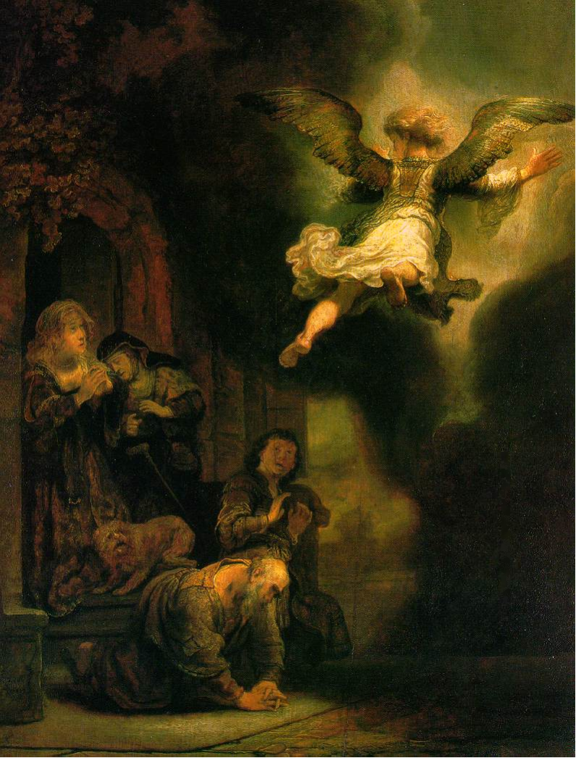
Malaikat meninggalkan keluarga Tobias
(This picture is on the front of your class notes)
Rembrandt, 1637
Notes:
http://www.google.com.sg/imgres?imgurl=keptar.demasz.hu/arthp/art/r/rembran/painting/biblic1/tobias.jpg&imgrefurl=http://keptar.demasz.hu/arthp/html/r/rembran/painting/biblic1/&h=1045&w=795&sz=134&tbnid=s5jpeQ2vX3oJ:&tbnh=149&tbnw=113&start=6&prev=/images%3Fq%3DBiblical%2Bfamily%26imgsz%3Dxxlarge%26svnum%3D10%26hl%3Den%26lr%3D%26ie%3DUTF-8%26safe%3Dactive%26sa%3DG

Slide 49
So do these books have any value?
163
Adakah nilainya?
Yes!
Sejarah Intertestamen
Sekte Yahudi dan institusi
Kepercayaan Theologi (e.g., angels)
Latar Belakang Leksikal (yang akan datang”)
Istilah Surat
Penyeimbang tulisan Rabi

Slide 50
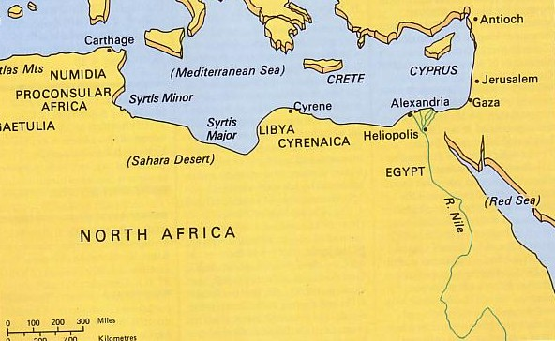
2. Philo dari Alexandria
Uninspired Jewish Writings
168
Metode Alegori
Mempengaruhi hermeneutik Kristen

Slide 51
Chronological Literature Chart
Dates show time of writing and works appear in italics
400 300 200 100 BC/AD 100 200 300 400 500 600 700
GREEK LXX
(Greek OT)
Polybius
Diodorus
Strabo
Plutarch
----- Hermetica ----
Philo
JEWISH ^{(Jewish/Greek)}
OT Jamnia “Council” MT
(completed) 600-1000
------OT Apocrypha-----
---------- Pseudepigrapha -------(some extended to 7th century)
- Dead Sea Scrolls -
---------------- Rabbinic Literature --------------
------------- Midrash (oral tradition) ----------
Talmud = Mishnah 200 + Gemara 500
--- Tosefta ---
Josephus 77-94
ROMAN (Jew writing for Rome)
Cicero
Livy
Pliny 113
Tacitus 115
CHRISTIAN
New Testament 40s-95
Apostolic Fathers 95-150
Most notable:
• Didache 95-120
• Epistle of Barnabas 70-132
----------------- NT Apocrypha ----------------
• Nag Hammadi Codices (Gnostic)
• Gospel of Thomas
MISCELLANEOUS
------------------------------- Select Papyri --------------------------------------------
158

Slide 52
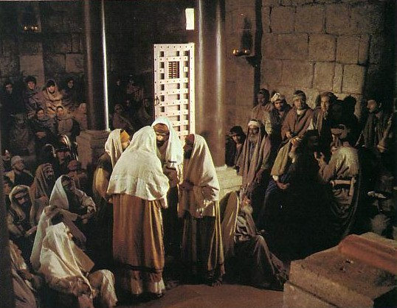

Sastra Rabinik
(100 BC-AD 500)
Uninspired Jewish Writings
168-170
Midrash
  Halakah
  Haggadah
Talmud
  Mishna
  Gemara
Tosefta

Slide 53
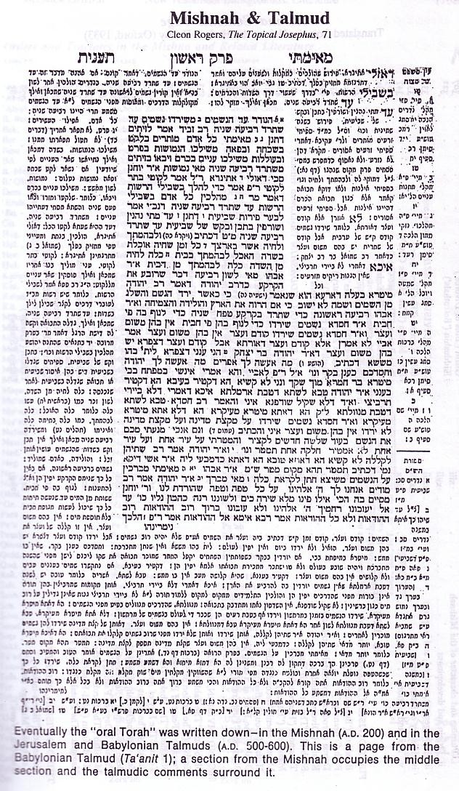

The Babylonian Talmud
169b
The Babylonian Talmud
Mishnah
— Hukum oral para rabi
  — AD 200
+
Gemara
  — Komentar tentang Mishnah
  — AD 500-600
Mishnah
Gemara

Slide 54
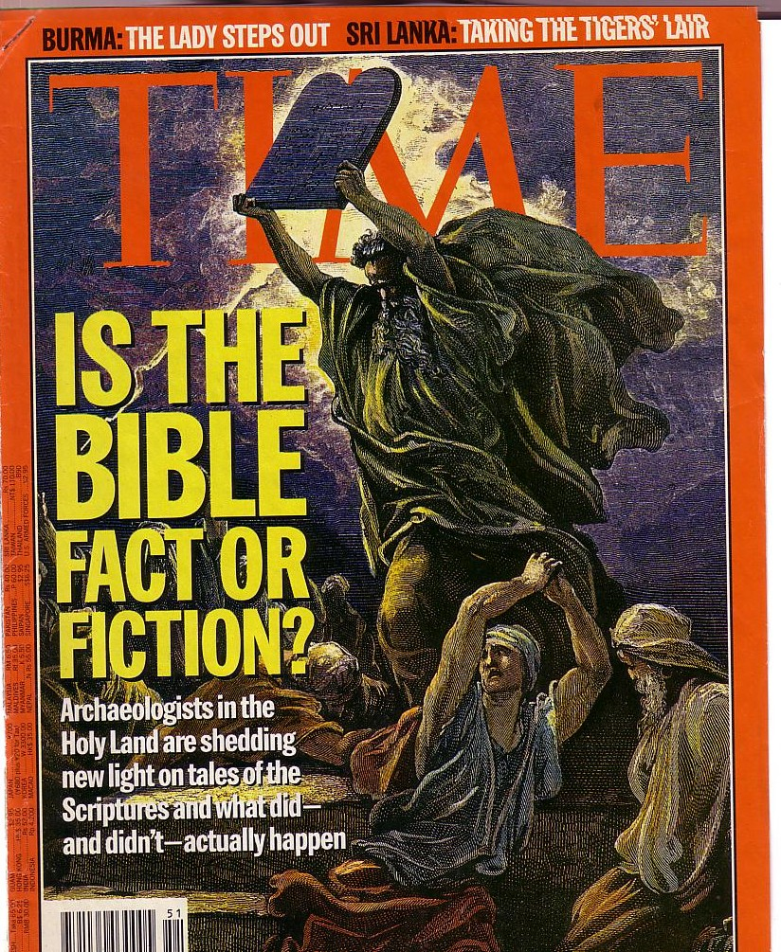
Attacks Continue
Alkitab diserang terus
Tetapi, penemuan terus menegaskan keakuratannya

Slide 55
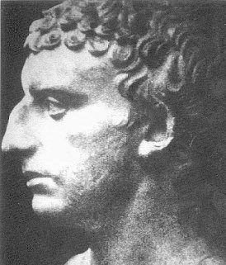
4. Josephus
Uninspired Jewish Writings
171
3 Fase Hidup:
Farisi
Umum
Sejarahwan
AD 37 – ca. 100

Slide 56
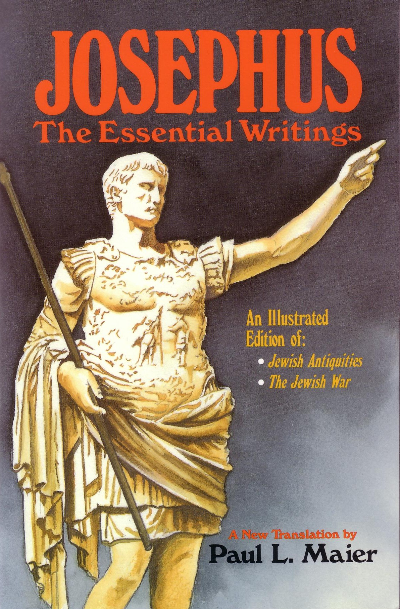
4. Josephus
Uninspired Jewish Writings
171
Tulisan:
Perang Yahudi (AD 77)
Antik (AD 93-94)
Hidup
Melawan Apion

Slide 57
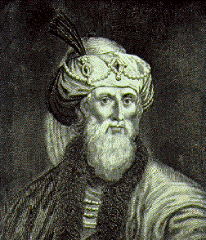
Evaluasi Josephus
Uninspired Jewish Writings
171
Sudut pandang Romawi
Berlebihan
Egotisme
Digressi

Slide 58
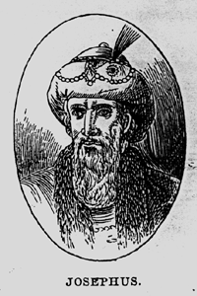
Signifikansi Josephus
Uninspired Jewish Writings
172
Saksi non-Kristen mula-mula terhadap sejarah Yesus Kristus

Slide 59
Kutipan singkat Josephus
Uninspired Jewish Writings
172
“Convening the judges of the Sanhedrin, he [Annas] brought before them a man named James, the brother of Jesus who was called the Christ, and certain others. He accused them of having transgressed the law, and condemned them to be stoned to death”
(Ant. 20.9.1 in Maier, 276; cf. Whiston, 4:140).
Josephus dengan inakurat menyebut Yudas saudara Yesus (cf. Kis 12:1-2).

Slide 60

Kutipan panjang (two versions)
Uninspired Jewish Writings
172
Jewish | Christian
“At this time there was a wise man called Jesus, and his conduct was good, and he was known to be virtuous. Many people among the Jews and the other nations became his disciples. Pilate condemned him to be crucified and to die. But those who had become his disciples did not abandon his discipleship. They reported that he appeared to them three days after his crucifixion and that he was alive. Accordingly, he was perhaps the Messiah, concerning whom the prophets have reported wonders. And the tribe of the Christians, so named after him, has not disappeared to this day.” | “About this time lived Jesus, a wise man, if indeed one ought to call him a man. For he was the achiever of extraordinary deeds and was a teacher of those who accept the truth gladly. He won over many Jews and many of the Greeks. He was the Messiah. When he was indicted by the principal men among us and Pilate condemned him to be crucified, those who had come to love him originally did not cease to do so; for he appeared to them on the third day restored to life, as the prophets of the Deity had foretold these and countless other marvelous things about him. And the tribe of Christians, so named after him, has not disappeared to this day.”

Slide 61
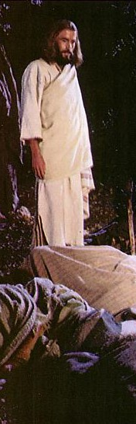

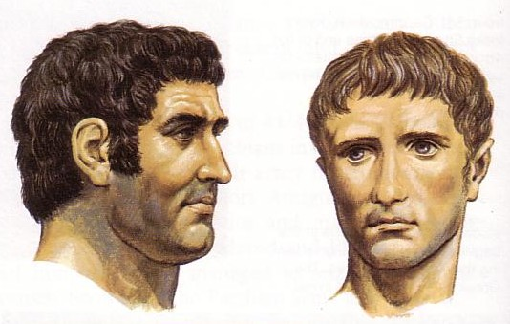
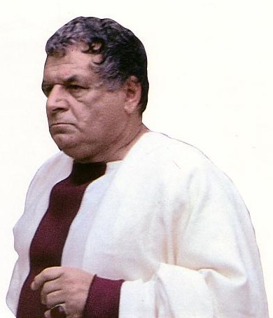
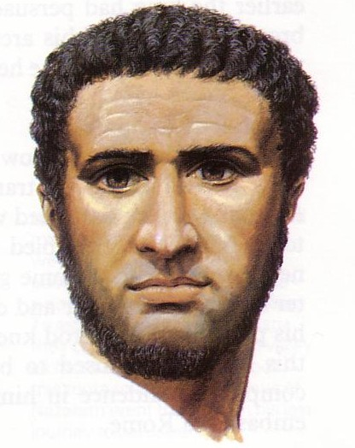
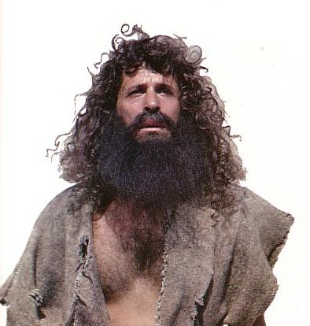
Signifikansi Josephus
Uninspired Jewish Writings
172
Earliest non-Christian witness to the historicity of Jesus Christ
Most important source for NT Backgrounds

Slide 62
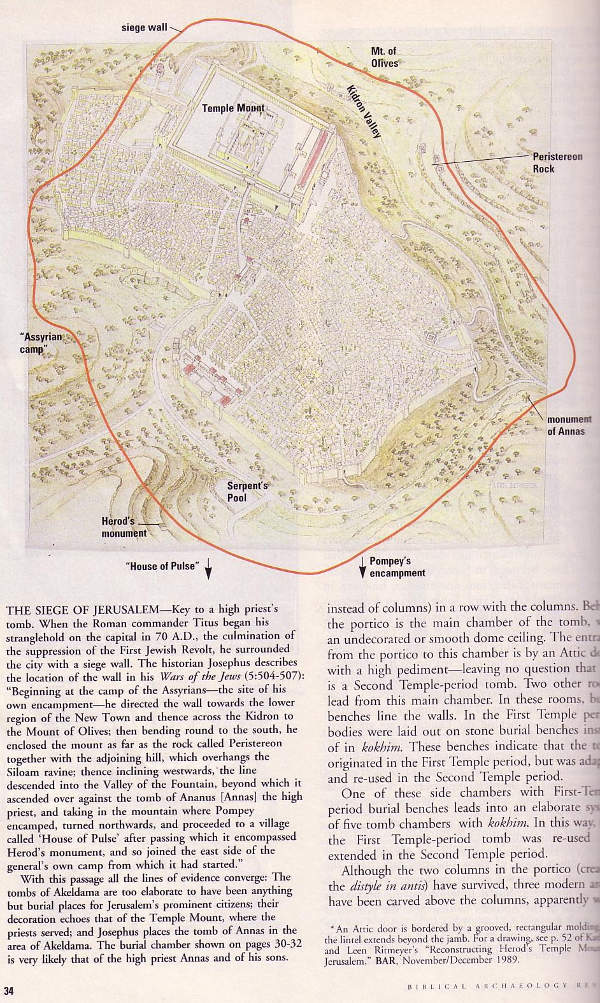
Pengepungan Yerusalem (AD 70)
Leen & Kathleen Ritmeyer, “Akeldama: Potter’s Field or High Priest’s Tomb?” BAR 20 (Nov/Dec 94): 34

Slide 63
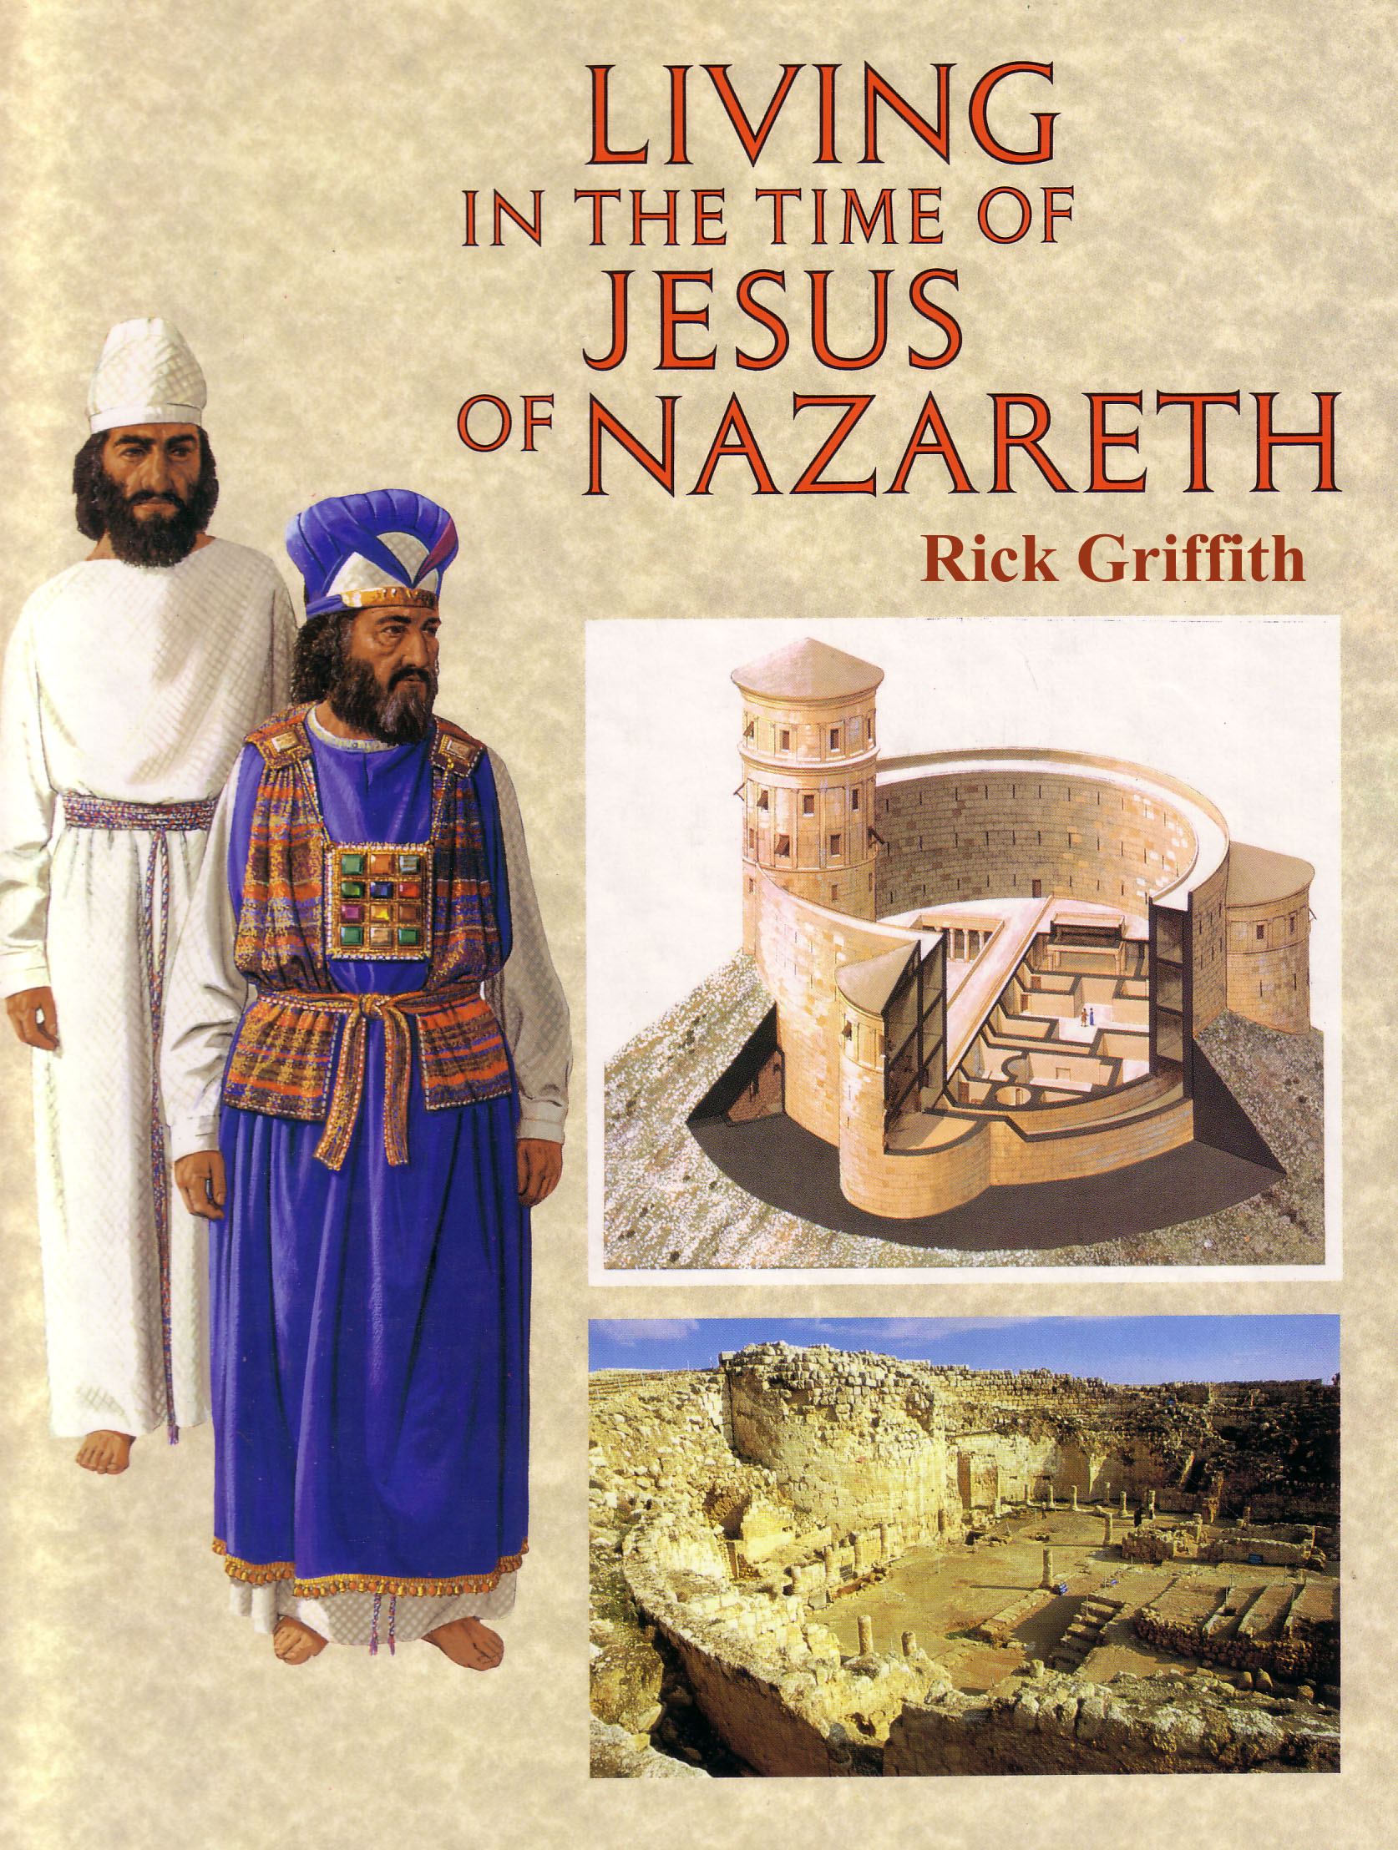
Signifikansi Josephus
Uninspired Jewish Writings
172
Saksi non-Kristen mula-mula terhadap sejarah Yesus Kristus
Sumber penting bagi latar belakang PB
Kehidupan Yahudi yang paling baik

Slide 64
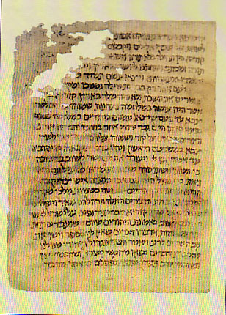
5. Gulungan Dead Sea
Uninspired Jewish Writings
174
GDS adalah penemuan sastra yang paling ekstensif tentang Alkitab
Karena itu kita akan membahas di sesi berikutnya

Slide 65
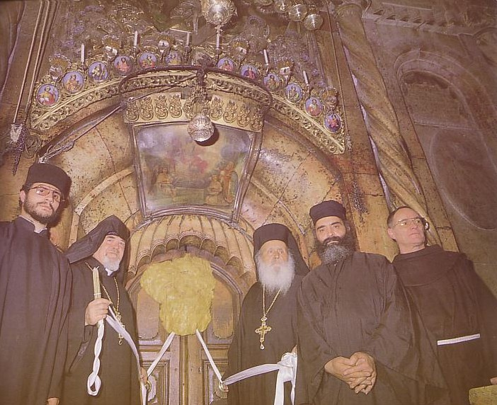
Sastra Kristen
The Didache
The Epistle of Barnabas
The Apostolic Fathers
186

Slide 66
Ajaran Didache (“Teaching”)
186
Guide mula-mula ke ajaran gereja
Baptis dengan aliran air (7.1)
Pertama baptis dengan menuang air ke kepala tiga kali (7.3)
Jika misionaris tinggal 3 hari dia nabi palsu (11.5)
Kebaktian hari Minggu atau Hari Tuhan (14.1)
“Tunjuk bishop dan dekan sendiri” (15.1)

Slide 67
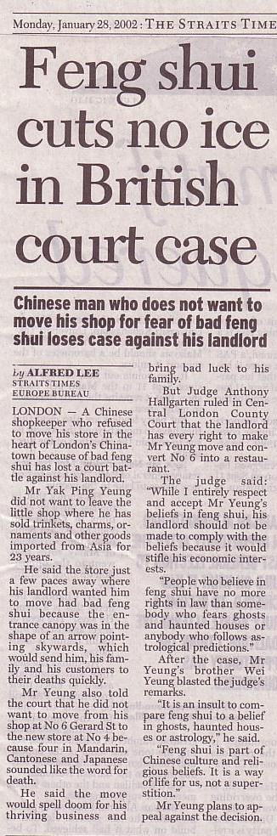
Sastra Gnostik
186
Ditolak
Apocrypha PB (AD 100-600)
Injil Thomas

Slide 68
Apocrypha PB: 18 Injil
186
GOSPELS
Arabic Gospel of the Infancy
Armenian Gospel of the Infancy
Assumption of the Virgin
Resurrection of Christ by Bartholomew
History of Joseph the Carpenter
Protoevangelium (Infancy Gospel) of James
Notes:
Brown supposes that “all gospels are created equal,” including these 16 heretical gospels that came a century after Christ.

Slide 69
Apocrypha PB: 18 Injil
186
Injil Dari:
• Bartholomeus • Kelahiran Maria
• Basilides • Pseudo-Matius
• Kerintus • Orang Ibrani
• Ebionit • Philipus
• Maria Magdalena • Thomas
• Marcion • Infancy Injil Thomas
Notes:
These Gnostic works do not amount to “80 gospels” as Brown claims. What they say is so esoteric that few read them.

Slide 70
Apocrypha PB: 21 “Kisah”
186
Apostolic Sejarah Abdias
Pecahan Cerita Andrew
Kenaikan James
Martir Matthew
Penderitaan Paulus
Penderitaan Petrus dan Paulus

Slide 71
Apocrypha PB: 21 “Kisah”
186
Kisah dari:
• Andrew
• Andrew and Matthias • Peter
• Andrew and Paul • Peter and Andrew
• Barnabas • Peter and Paul
• James the Great • Philip
• John • Pilate
• John by Prochorus • Thaddeus
• Paul • Thomas

Slide 72
Apocrypha PB: Lainnya
186
APOCALYPSES
James Stephen
Paul Thomas
Peter the Virgin
Surat
Surat dari Christ dan Abgarus
Surat dari Rasul
Surat ketiga ke Korintus
Surat ke Laodiceans
Surat Lentulus
Surat dari Paul dan Seneca
Apocryphal Surat dari Titus

Slide 73
Gnostik mula-mula di 1 John
186
Dua Type
Docetic Gnosticism
Matter is Evil
Depreciated Materialism
Denied Christ’s Humanity
Touched Jesus (1:1)
Asceticism
Immorality
Cerinthian Gnosticism
Spirit is Good
Exalted Knowledge (gnosis)
Denied Christ’s Deity
Water & Blood (5:6)
Pride
Education

Slide 74
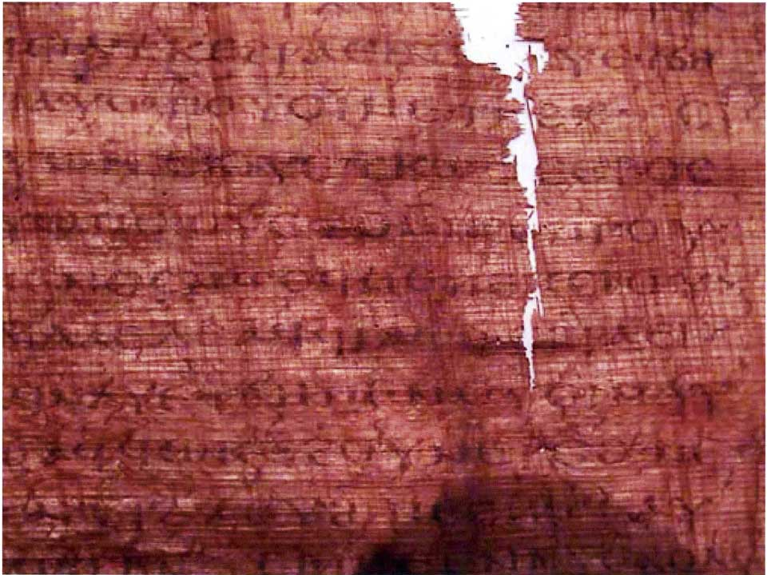
Injil Yudas
Judas said, “Master, could it be that my seed is under the control of the rulers?” Jesus answered and said to him, “… you will grieve much when you see the kingdom and all its generation.” When he heard this, Judas said to him, “What good is it that I have received it? For you have set me apart for that generation.” Jesus answered and said, “You will become the thirteenth, and you will be cursed by the other generations—and you will come to rule over them. In the last days they will curse your ascent [47] to the holy [generation].”

Slide 75
Injil Yudas
Judas said to Jesus, “Look, what will those who have been baptized in your name do?” Jesus said, “… Truly [I] say to you, Judas, [those who] offer sacrifices to Saklas [...]God [—three lines missing—] everything that is evil. But you will exceed all of them. For you will sacrifice the man that clothes me.”

Slide 76


How should we fight heresy?

Slide 77
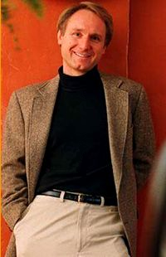
Tertawa sambil berjalan ke bank…
$260 juta setelah 12 juta copy terjual
$100 juta dari buku lain
Sekarang 40 juta buku terjual

Slide 78
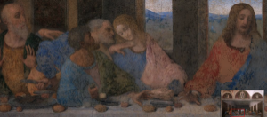
Siapa ini?
Yohannes?
Atau Maria?
Brown bilang “Yohannes” sebenarnya Maria Magdalena, istri Tuhan Yesus!
Tetapi, da Vinci hanya menggambarkan Yohannes sebagai “pemuda yang cantik” gaya Florentine

Slide 79
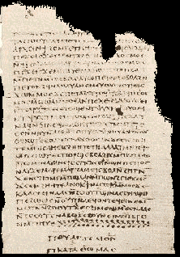
Maria Magdalena sebagai istri Kristus?!
And the companion of the [...] Mary Magdalene. [...] loved her more than all the disciples, and used to kiss her often on her mouth. The rest of the disciples [...]. They said to him "Why do you love her more than all of us?”
Injil Philip
(Gnostic NT Apocrypha)
http://www.gnosis.org/naghamm/gop.html
Notes:
http://www.gnosis.org/naghamm/gop.html
Image is of the Gospel of Thomas on the same site.

Slide 80
Maria Magdalena sebagai istri Kristus?!
And the companion of the [...] Mary Magdalene. [...] loved her more than all the disciples, and used to kiss her often on her mouth. The rest of the disciples [...]. They said to him "Why do you love her more than all of us?”
The Gospel of Philip
(Gnostic NT Apocrypha)
Tapi…
Jika Yesus menikah kenapa murid-murid musti iri?
Teman tidak pasti istri. Yesus punya beberapa teman perjalananan, banyak diantara mereka wanita.
Kata “mulut” dicoret di dokumen asli dan hanya ditambahkan oleh penerjemah. Bisa saja tangan, pipi, kepala.
Ini adalah karya heretik Abad Kedua.
Notes:
http://www.gnosis.org/naghamm/gop.html
Image is of the Gospel of Thomas on the same site.

Slide 81
Catatan Huruf Yunani dan Ibrani
BWHEBB, BWHEBL [Ibrani]; BWGRKL, BWGRKN, and BWGRKI [Yunani] Postscript® Type 1 and TrueType™ fonts Copyright © 1994-2002 BibleWorks, LLC. All rights reserved. These Biblical Greek and Hebrew fonts are used with permission and are from BibleWorks, software for Biblical exegesis and research.

Slide 82
Black

Slide 83


Latar Belakang Perjanjian Baru— BibleStudyDownloads.org
Dapatkan slide ini tanpa biaya
Notes:
New Testament Backgrounds PPT in Bahasa Indonesia

